Slide 1
Personalized Emergency Reporting and Notification System
Ambuj Fotedar
Jash Pithadia
Zain Zahid

Slide 2
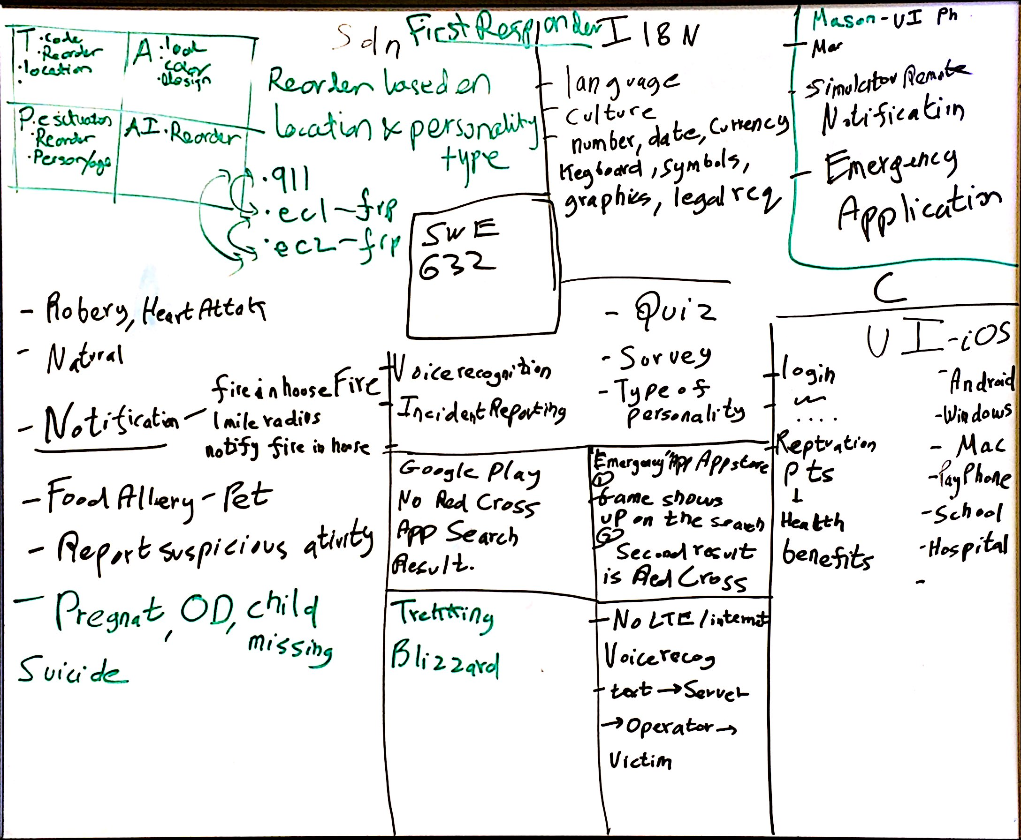

Slide 3
USABILITY THEORIES
Color Theory
Dreyfuss Design Principle
Skeuomorphism
Gestalt Design Principle
Shneiderman’s 8 golden rules
Fitt’s Law
Myers Briggs Type Indicator
Norman’s stages of action
Internationalization (I18N)

Slide 4
Thank you

